Slide 1

Internship at The SwiftPath Program
Pranav Sakthivel

Slide 2

Company Overview
Healthcare company focused on having patients out of hospital ASAP after joint replacement surgery
Online JointCamp
SwiftPath Algorithms, get patient to right medical provider

Slide 3









Technologies Used
ReactJS/NodeJS
JavaScript, C#, PHP
GitHub, Slack
Azure Cloud Services
Azure App services
Azure function apps
Azure SQL/NoSQL
Azure Logic Apps/Power Apps
PowerBI Embedded

Slide 4
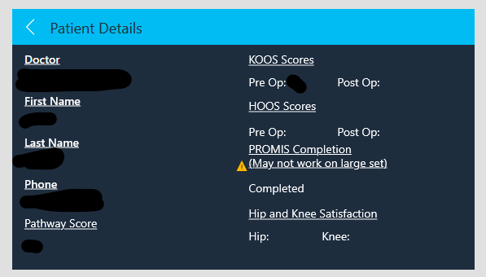
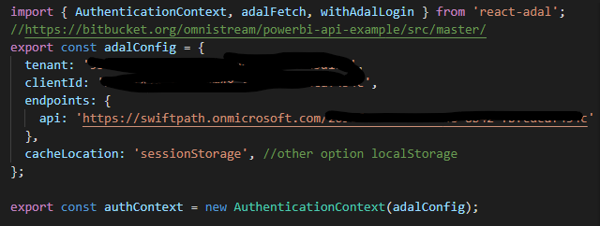
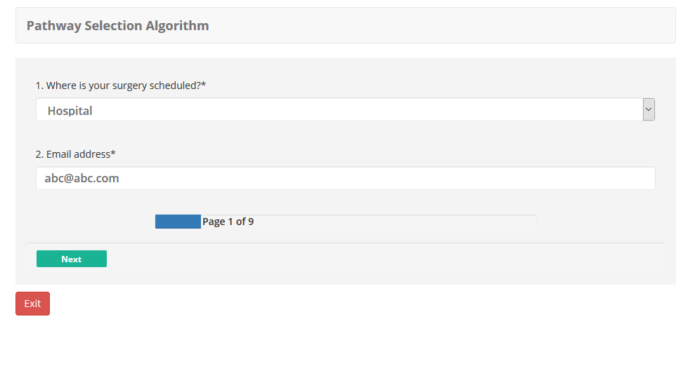
Goals & Projects I Worked On
Pathway Selection Algorithm
Appropriateness Algorithm
PowerBI Embedded Frontend
PowerBI Embedded
Active Directory
C# Function App
Pain Alerts
Patient Search PowerApp

Slide 5
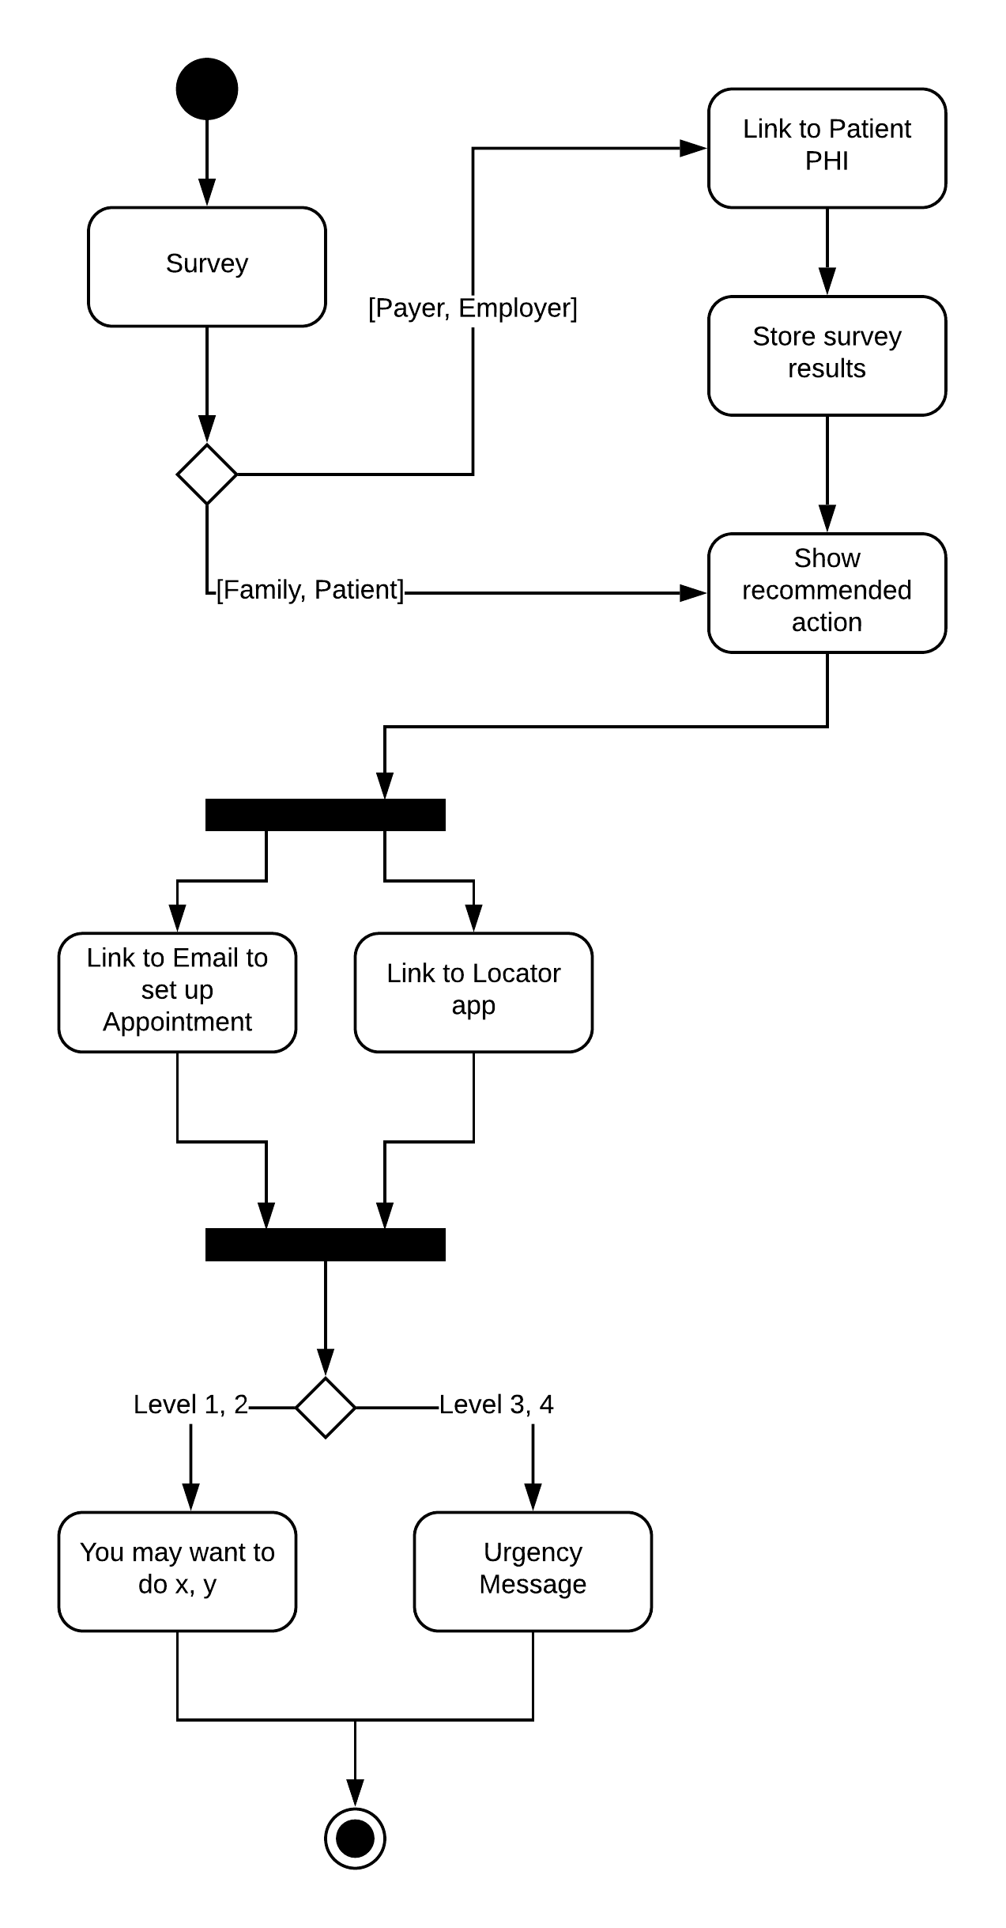
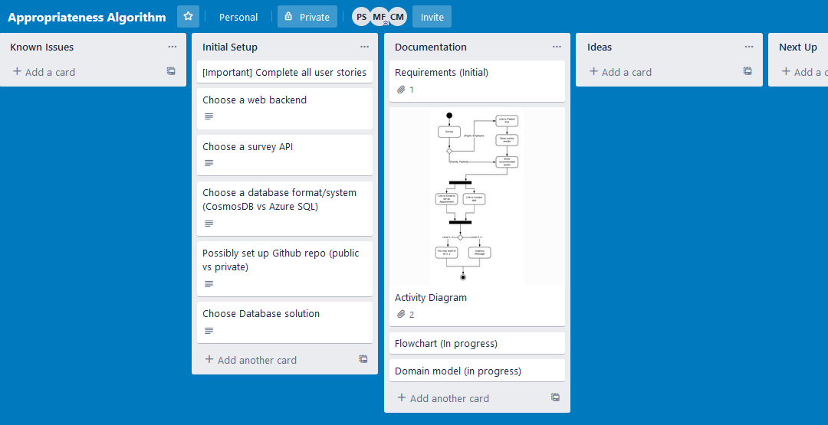
Project Planning Methods

Slide 6
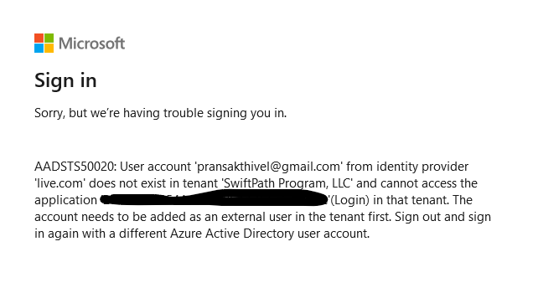
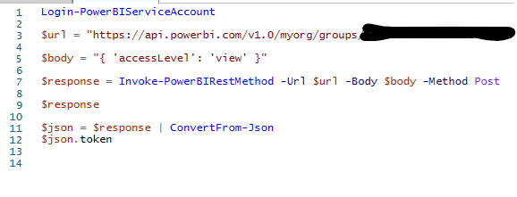
What I learned
Azure Cloud Services
Coding in a production environment
Working with a small team
Understanding stakeholder requirements
Prototyping
Code for changeability

Slide 7

Useful Courses
CSS 436 – Cloud Computing
Knowledge of cloud services such as Azure, AWS
CSS 342/343 – Data Structures in Algorithms
Programming fundamentals and knowledge in strongly typed languages
CSS 370 – Analysis and Design
CSS 360 – Software Engineering
Agile methodologies
CSS 475 – Database Systems
Modeling relational databases

Slide 8
